Slide 1
Research Designs for Program Evaluation
M&E for HIV/AIDS Programs
March 2011

Slide 2
Why Evaluate
Donor/funding requirement?
Knowledge
Program planning
Policy formulation

Slide 3
Nomenclature
Types
Timing

Slide 4


Slide 5
Causality
Temporal relationship
Plausibility
Consistency
Strength
Dose response relationship
Reversibility
Study design
Judging the evidence

Slide 6
Determining the cause and effect
Higher levels of peer educator work performance will lead to higher rates of consistent condom use among youth .

Slide 7
Determining the cause and effect
Higher levels of peer educator work performance will lead to higher rates of consistent condom use among youth .

Slide 8
Determining the cause and effect
Reduced levels of stigma and discrimination will lead to more people seeking VCT

Slide 9
Determining is the cause and effect?
Reduced levels of stigma and discrimination will lead to more people seeking VCT

Slide 10
Comparing two groups and identifying the cause and effect
PLHA who receive comprehensive counseling on ART that includes discussions on side effects and their management before ARV treatment begins are more likely to adhere effectively to treatment after a year than PLHA who have not received counseling on ARVs before they begin therapy

Slide 11
Comparing two groups and identifying the cause and effect
PLHA who receive comprehensive counseling on ART that includes discussions on side effects and their management before ARV treatment begins are more likely to adhere effectively to treatment after a year than PLHA who have not received counseling on ARVs before they begin therapy

Slide 12
Comparing two groups and identifying the cause and effect
Dual protection programs that focus on counseling women together with their male partners will be more successful than dual protection programs that focus on counseling women alone

Slide 13
Comparing two groups and identifying the cause and effect
Dual protection programs that focus on counseling women together with their male partners will be more successful than dual protection programs that focus on counseling women alone
Describe the groups
What are the causes
What are the effects

Slide 14
Evaluation: outcome & impact
Cause and effect relationship
Other terms
  Independent and Dependent

Slide 15
Epidemiological study designs
Observational
  Descriptive
  Analytical
Experimental

Slide 16
One of the main questions for evaluating a program is:
How much of the observed change in the health outcome of the target population can be attributed to the program ?
Key issue is causality and to be able to isolate the impact of the program.

Slide 17
Intervention
Treatment
Service
Programme
Product
Policy
Standards and procedures

Slide 18
Evaluating Program Impact
Outcome
The Evaluation
Question:
How much of
this change
is due to the
program?
Program
start
Program
midpoint or end
Time

Slide 19
Evaluating Program Impact
Outcome
With
program
Net Program
Impact
Without
program
Program
start
Program
midpoint or end
Time

Slide 20
A B C

Slide 21
Confounding variables
Something other than the intervention which could influence the measured outcome

Slide 22
Control group
A group of people
Or organisation
That does not get the intervention

Slide 23
matching
Ensuring that people or organisations in the experimental group and control groups are the same in all characteristics which could affect the outcome of the intervention given to the experimental group

Slide 24
randomization
Allocating people in a random way to an
experimental or a control group

Slide 25
Results would have
been obtained if
program had never
been implemented
Program Impact =
Results with
program
-
The Evaluation Problem:
The second term, called the counterfactual, is unknown (we never observe the same individual both exposed and not exposed to the program at the same time)
However, it can be estimated.
There are different sets of procedures for estimating the counterfactual. These procedures differ in the way that they “estimate” the second term.

Slide 26
Evaluation Designs
Set of procedures that guide the collection of data in order to identify a credible counterfactual and to answer the evaluation question. Estimation procedures are associated with evaluation designs

Slide 27
Finding a good counterfactual
To “estimate” or to have a proxy of the counterfactual we need to use information from a group that was not exposed to the program.
Can we use a group of non-participants?

Slide 28
Key Issues to consider for evaluation design:
I. Multiple factors influence the behavior or health outcome of interest. The program is only one factor among many (see conceptual framework next). So, design and analytical challenge is how to control for the influence of multiple other factors and correctly estimate the net program impact

Slide 29
Simple Conceptual Framework of health outcomes …….……..
Individual / Household
- Age
- Education
- Household wealth/SES
- Preferences
- Risk aversion
- Biological endowments
Healthy
Behavior
Healthy
Outcomes
Health Service Supply/ Community
- Health facilities Access
Price
Quality
- Fieldworkers Number
Quality
- IEC campaign
- Other sources of health service
- Sanitation
- Schools

Slide 30
Simple Conceptual Framework of health outcomes
Which factors do we observe?
Observed ?
Yes
Yes
Yes
No
No
No
Individual / Household
- Age
- Education
- Household wealth/SES
- Preferences
- Risk aversion
- Biological endowments
Healthy
Behavior
Healthy
Outcomes
Health Service Supply/ Community
- Health facilities Access
Price
Quality
- Fieldworkers Number
Quality
- IEC campaign
- Other sources of health service
- Sanitation
- Schools
Observed ?
Yes
No
No
Yes
No
Yes
No
No
No

Slide 31
Key Issues to consider for evaluation design:
II. Selection into the program
Participation into the program is in many cases the decision of the individuals or the program managers. There is no guarantee that the group of program participants has similar characteristics to the group of non-participants.
Examples:
- Voluntary participation of individuals in program
- Targeted placement of program services across communities
Problem if selection on basis of unobserved factors: Selection Bias

Slide 32
Simple Conceptual Framework of health outcomes (Individual participation in program)
Individual / Household
- Age
- Education
- Household wealth/SES
- Preferences
- Risk aversion
- Biological endowments
Program participation
Healthy
Behavior
Health Service Supply / Community

Slide 33
Simple Conceptual Framework of health outcomes
(presence of program in community)
Individual / Household
Healthy
Behavior
Community
- Schools
- Non-program health
service sources
Community leaders of
opinion and influence
Sanitation
Program presence

Slide 34
Key Issues to consider for evaluation design:
So, a good evaluation design addresses both confounding and selection into the program.
It also:
- should provide data that represent well the program target population
- It should provide a “window of observation” that corresponds to the time needed for the program to have impact

Slide 35
Designs for Evaluating Program Impact:
Experimental design
Observational design :
  Quasi-experimental
  Non-experimental

Slide 36
Basic Framework for Evaluating Program Impact
PROGRAM
Group 1
(Treatment)
Group 1
(Treatment)
Population
Group 2
(Control)
Group 2
(Control)
If “Random Assignment”:
Group 1 ≠ Group 2 Difference due to program
Group 1 = Group 2
If Non-random Assignment: (Survey data)
Group 1 ≠ Group 2 Difference due to program and pre-existing differences (observed and unobserved)
Group 1 ≠ Group 2

Slide 37
Experimental Design
Individuals are randomly assigned into a Treatment group and a Control group
If well implemented and sample is large enough, random assignment will make the pre-program treatment and control groups similar on observed and unobserved characteristics. That is, in absence of program, there is no difference in the outcome of the two groups.
The control group serves as the counterfactual, and:
Program Impact = Average(“Treatment”) - Average(“Control”)

Slide 38
Experimental Design
Few conditions are needed:
+ Assignment to program is random
+ Program “intensity” is homogenous
+ No spillover effect
+ Individuals in “Treatment” group do not change behavior because
of participation in experiment (no Hawthorne Effect)
+ External factors influence both groups equally
+ Individuals remain during duration of experiment (or at least no selective attrition)
Randomized Controlled Trial (RCT) frequently used for clinical trials, vaccines, new drugs.
Classic experimental design is the gold standard

Slide 39
Experimental Design (Contd.)
However,
+ Difficult implementation (practical, political or ethical)
+ Contamination is possible (spillover effects from the program to the Control group or from other programs in the treatment group)
+ Hawthorne effect
+ Selective attrition
+ Program are complex interventions with multiple components
+ Generalization is questionable (external validity)
+ Costly implementation
Also, outcomes are affected by factors from multiple levels, so randomization at a higher level does not guarantee that factors from lower-levels will be evenly distributed between the treatment and control group.

Slide 40
Types of Experimental Designs
Pretest-Posttest Control Group Design: Classic experimental
  O1 X O2 Treatment
  O3 O4 Control
  [R] = randomization
  X = Treatment. O1…O4 = Group observation at time T
  Program impact = (change in Treatment) – (change in Control)
  [O2-O1] – [O4-O3] +/- error
Baseline provides confirmation that two groups are equivalent
Needs “before” and “after” measurement
[R]

Slide 41
Types of Experimental Designs
Posttest Control Group Design
  X O1 Treatment
  O2 Control
  [R] = randomization
  Program impact = (Difference between Treatment and Control)
  [O1-O2] +/- error
Randomization should ensure that Treatment and Control Groups are equivalent, but there is no confirmation of that assumption
[R]

Slide 42
Types of Experimental Designs
Four-Group Pretest-Posttest Control Group Design
  O1 X O2
  O3 O4
  X O5
  O6
  [R] = randomization
It allows to examine effect of testing and the interaction between testing and treatment: O2 and O4 might have effect of pre-test, while O5 and O6 do not have effect of pre-test
[R]

Slide 43
Experimental Designs, Examples
Taichung, Taiwan study
Objective: to assess impact of FP program on contraceptive awareness and use
Set up: Local areas (lins) were randomly assigned to one of four experimental groups: three intervention groups and a control group
1. Full package to Husband and wife
2. Full package to wife only
3. Mailing of FP information
4. Control
Full package: visits of health workers, mailing and community meetings
Posttest Control group design.

Slide 44
Experimental Designs, Examples
Taichung, Taiwan study
Results:
Contraceptive Acceptance Rates
13 months 29 months
- Full package, Hsbd & wife 17 25
- Full package, wife only 17 26
- Mailing only 8 16
- Control 8 18

Slide 45
Experimental Designs, Examples
Bauman et.al. (1994) presents several examples of experiments
Used for assessing interventions of voluntary HIV counselling and testing

Slide 46
Observational Designs
There is no random assignment of individuals to treatment/control groups
In consequence, there is no guarantee that “other” relevant factors are equivalent between the “participant” and “non-participant” groups
Observational designs, often referred as Quasi-experimental and Non-experimental designs, use matching techniques and statistical procedures to try to approximate the conditions of a experiment to control for multiple factors and to approximate a “control” group

Slide 47
Observational Designs (Cont’d)
Observational designs use the same framework for evaluating a program: An evaluator still needs data from a group exposed and a group not exposed to the program.
In the standard literature the non-participant group is called a “non-equivalent control group” or the “comparison” group

Slide 48
Quasi – experimental Designs
Key: to find the “comparison” group
Two methods: Matching and Reflexive Comparison
Matching
It constructs a “comparison” group by selecting a group among non-participants with characteristics similar to those of the program participants.
Matching on basis of characteristics that are relevant to program outcomes
Matching criteria:
  For Individuals : demographic, ethnicity, SES, location
  For Groups: By geographic area “similar” to program area or population sub-group “similar” to participating sub-group (example, clinics, schools)

Slide 49
Quasi – experimental Designs
Example: Matlab, Bangladesh
Quasi-experiment design based on geography.
150 villages received distribution of pills and condoms through Lady Village Workers (treatment)
83 villages as comparison groupcontrol)
Intervention: household visits to distribute methods, no counseling or follow-up

Slide 50
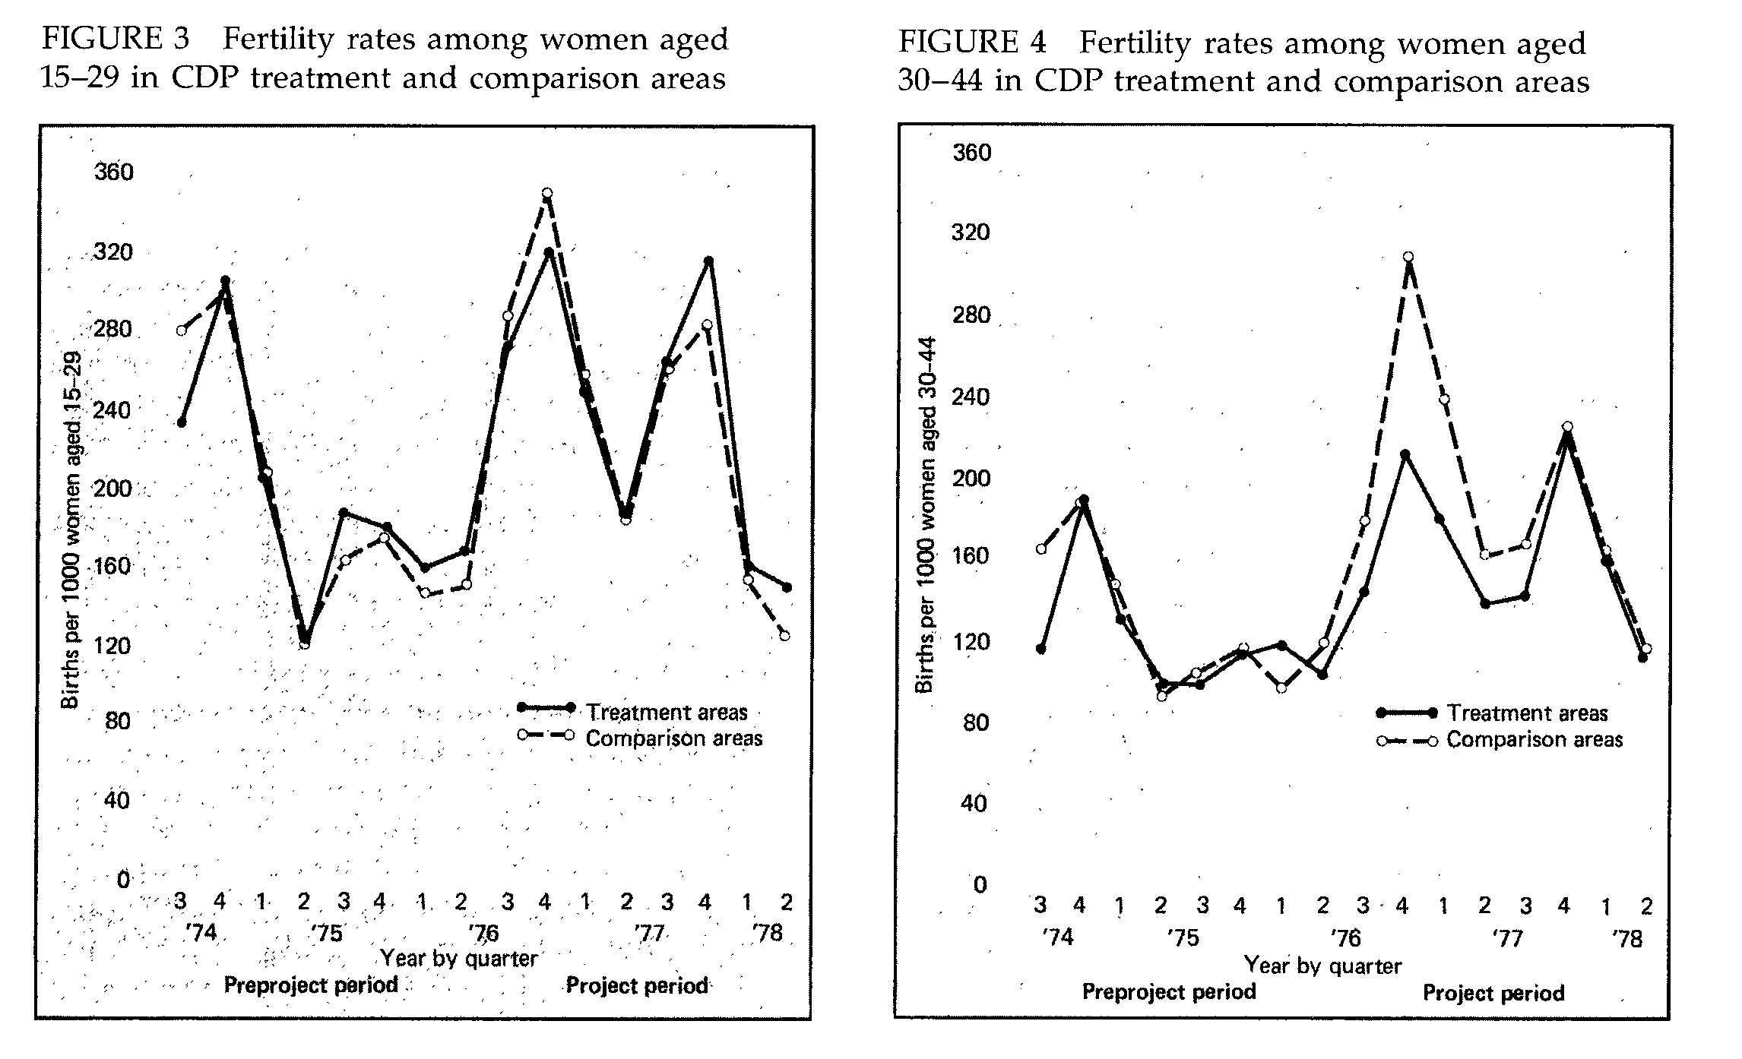

Slide 51
Quasi – experimental Designs: Reflexive Comparison
It uses time series data on participants and impact is assessed by comparing average change in outcome before and after the intervention
O1 O2 O3 X O4 O5 O6
Comparison group is the situation of program participants before the program
Limitation: Change can be due to other factors
Needs very careful design

Slide 52
Quasi – experimental Designs: Reflexive Comparison
Example
K. Foreit, et.al. 1989. “The Impact of Mass Media Advertisement on a Voluntary Sterilization program in Brazil” in Studies in Family Planning
It used before and after time series service data to evaluate impact of advertisement through eight national magazines on new client volume in a clinic in Sao Paulo
Results: Mean daily vasectomies increased by 76% from baseline period

Slide 53
Non-experimental designs
It requires to specify an empirical model of the outcome of interest and to use regression analysis to control for multiple factors and selection into the program
The empirical model is based on a conceptual framework
Since the source of bias is selection into the program, the empirical model might need to include a program participation equation

Slide 54
Non-experimental designs
Main equation: Y_{ij} = f( X_{ij} , Program_{j} , Z1_{j} , μ_{j} , ε_{ij} )
where:
Y_{ij} = Outcome of interest
X_{ij} = Individual characteristics, observed
Program_{j} = Program services in community, observed
Z1_{j} = Community characteristics, observed
μ1_{j} = Community characteristics, unobserved
ε_{ij} = Individual-level error term
Program participation equation: Program_{j} = f( Z2_{j} , μ_{j} )
Where,
Z2_{j} = Community characteristics, observed
μ_{j} = Community characteristics, unobserved
Estimation requires variables that influence program placement but no the outcome Y (called Instrumental variables)

Slide 55
Non-experimental designs
If you have panel data and your model is linear, alternative procedure to control for unobserved factors is Difference-in-Difference model:
At time 1: Y_{ij1} = α₀ + α₁ X_{ij1} + α₂ Program_{j1} + α₃ Z_{j1} + μ_{j} + ε_{ij1}
At time 2: Y_{ij2} = α₀ + α₁ X_{ij2} + α₂ Program_{j2} + α₃ Z_{j2} + μ_{j} + ε_{ij2}
Take difference Time 2 – Time 1:
(Y_{ij2}–Y_{ij1})= α₁(X_{ij2} – X_{ij1}) + α₂(Program_{j2} – Program_{j1})+ α₃(Z_{j2} – Z_{j12})+ (ε_{ij2 –} ε_{ij1})
Notice that the unobserved factors μ_{j} were differenced out. You assume μ_{j} term is fixed (unobserved factors do not change over time)

Slide 56
Summary of Evaluation Design Issues
Impact evaluation requires to estimate a “counterfactual”
Multiple factors influence the health outcome
Several relevant factors are unobserved
Selection into the program is decided by the individuals
Program allocation is decided by program managers
Incomplete data means that we have to control for unobserved factors
Randomization “balances” the distribution of observed and unobserved factors between participants and non-participants
Non-randomization designs are used for evaluation programs but might not control for unobserved factors in a satisfactory way

Slide 57
So, for evaluation design
Develop a clear and simple conceptual framework
Identify your target population
Identify a group that could serve as a “comparison” group
Guide your data collection with conceptual framework
If program is targeted, collect data on factors influencing program targeting
Make sure sample of analysis is representative of target population
Make a case for randomization

Slide 58
So, for evaluation design
Recommendations:
Design and implement an evaluation plan at the beginning of the program, not at the end.
If you start after the program began, you might have missed the opportunity to get data on:
+ Baseline situation
+ A group of non-exposed (comparison group)
+ Relevant factors that influence the outcome (even data
on the program)

Slide 59
